Slide 1
Hrs workforce travel
user guide
april 2025

Slide 2
content
1 | Create project | Page 03
2 | Create group | Page 08
3 | Booking process | Page 16
4 | Solving booking issues | Page 25
5 | Managing bookings | Page 26

Slide 3
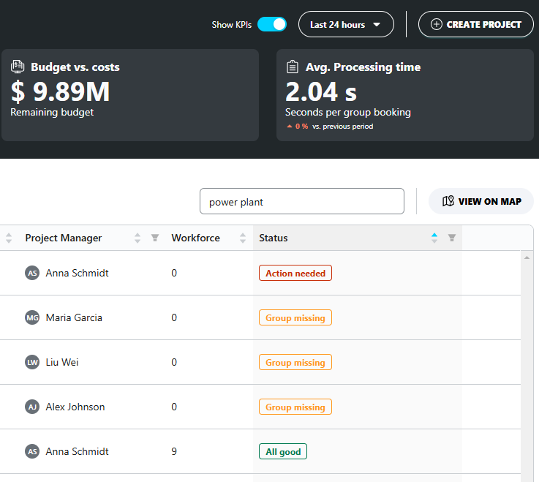
Section 1
Create project
    Step 1: Log into the HRS Workforce Travel platform
    Step 2: Click on “Create Project”
3

Slide 4
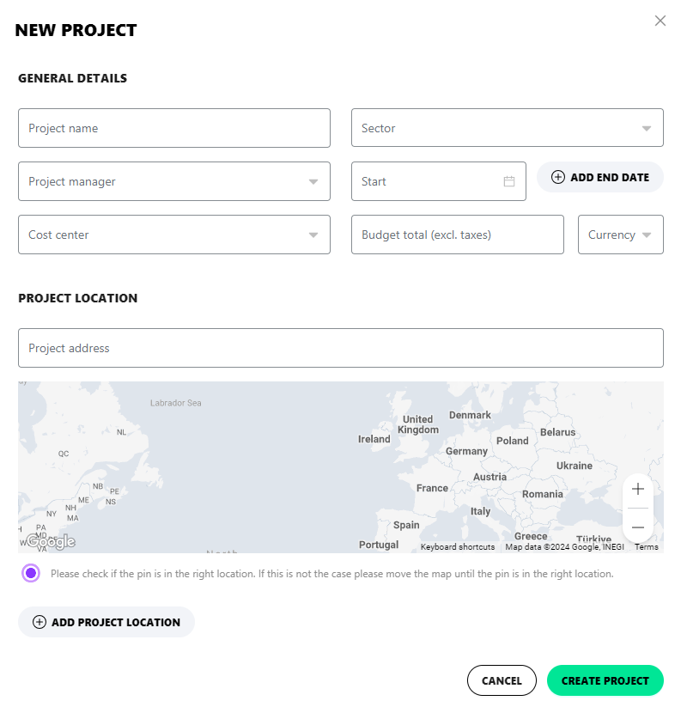
section 1
Create project
Step 3: Complete the general project details (use the drop-down to select the pre-populated options)
4

Slide 5
section 1
Create project
Step 4: Enter the project address (click on “Add Project location, if more than one location is related to the project)
Step 5: Click on “Create Project” to complete the process
5

Slide 6
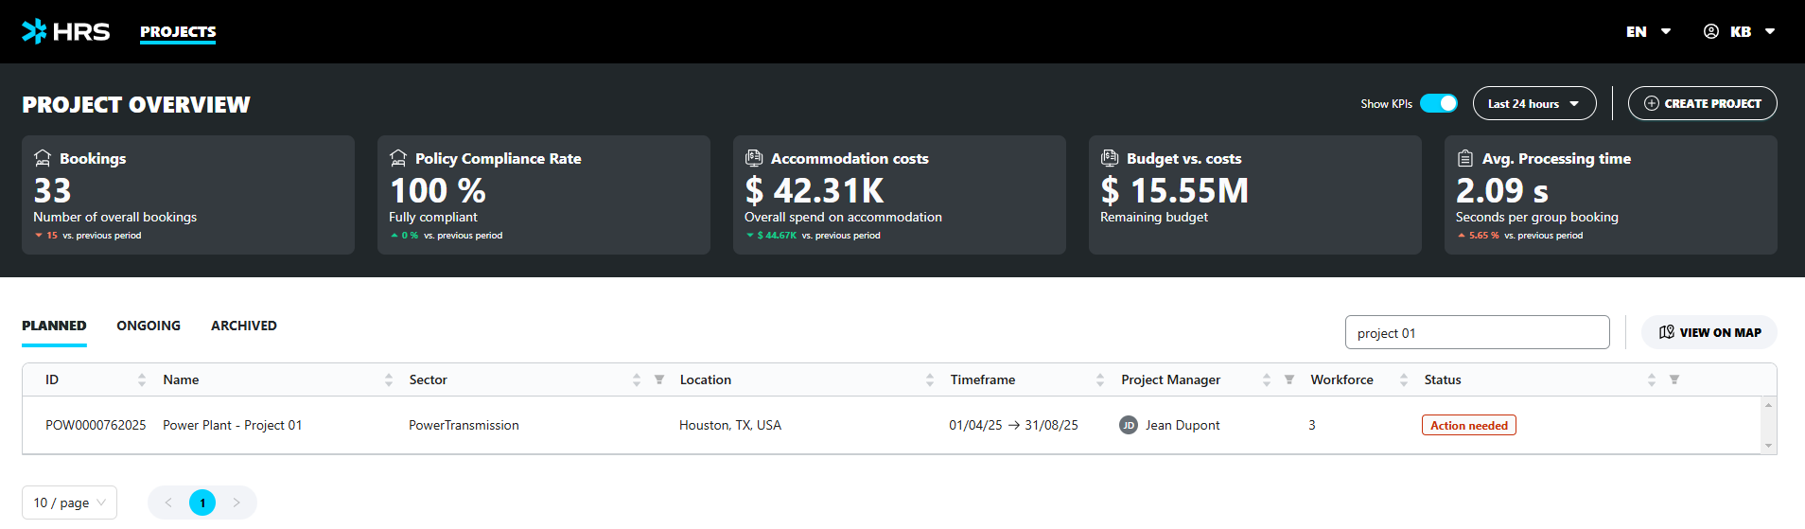
section 1
NOTE: All projects will be immediately added to the Project Overview and the KPIs will be automatically updated
Create project
6

Slide 7



section 1
Status | Explanation
 | Workforce stay has been booked successfully
 | There is an open task for one or more groups – check the project for more info
 | A group must be added to the project
Create project
Note: The project status will indicate if any actions must be taken
7

Slide 8
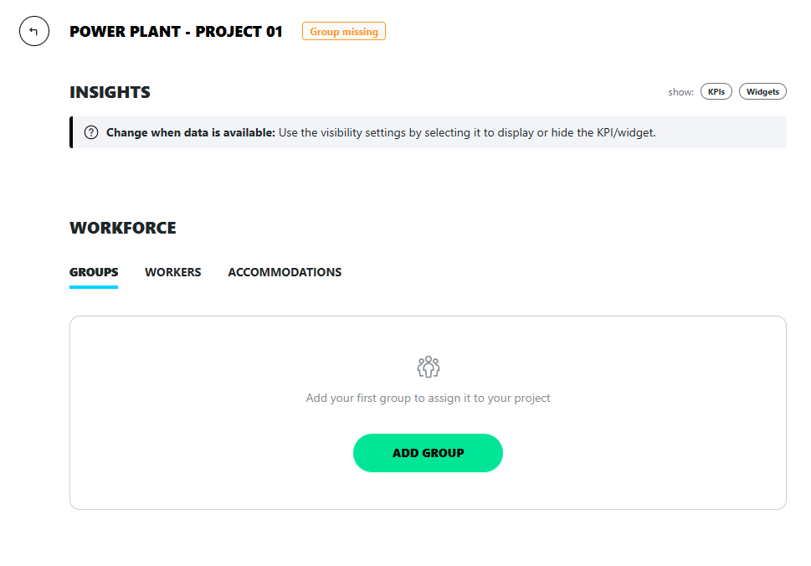
section 2
Create group
Step 1: On the project summary page, click on “Add Group”
8

Slide 9
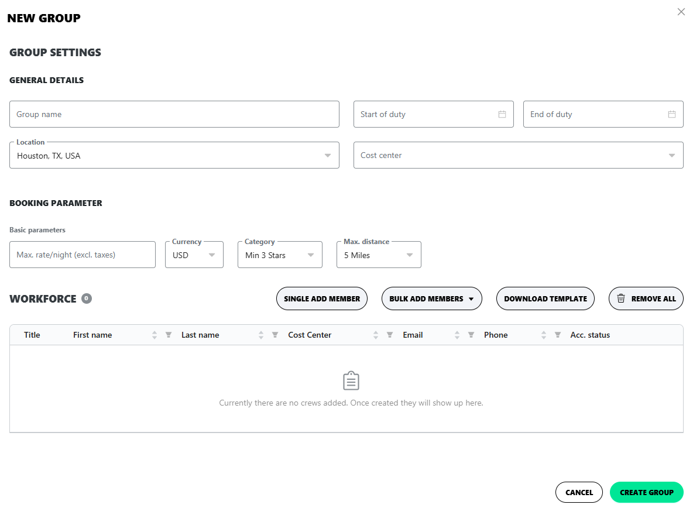
section 2
Create group
Step 2: Complete the general details (use the drop-down to select one of the location informed during the project setup process)
9

Slide 10
section 2
Create group
Step 3: Complete the booking parameters – this information will be used to present the best accommodations available for the group
10

Slide 11
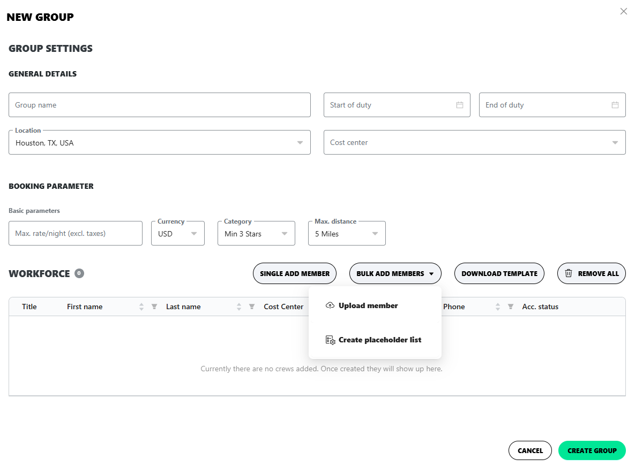
section 2
Create group
Step 4: There are 3 ways to add the workforce (traveler) information:
Add travelers manually:
Click on “Single Add Member”, enter the traveler’s email, complete the form to create a new crew member
Upload traveler list:
Download and fill out the excel template, click on “Bulk Add Members” and upload the list
11

Slide 12
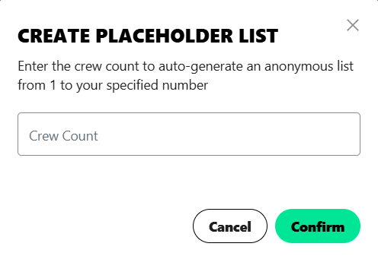
section 2
Create group
Option: Rooming List Management (create a Rooming List with anonymous traveler's names when you don’t have a crew list yet and have contracted hotels with allotments):
Click on “Bulk Add Members”, “Create placeholder list, enter the number of crew members and click on “Confirm”
12

Slide 13
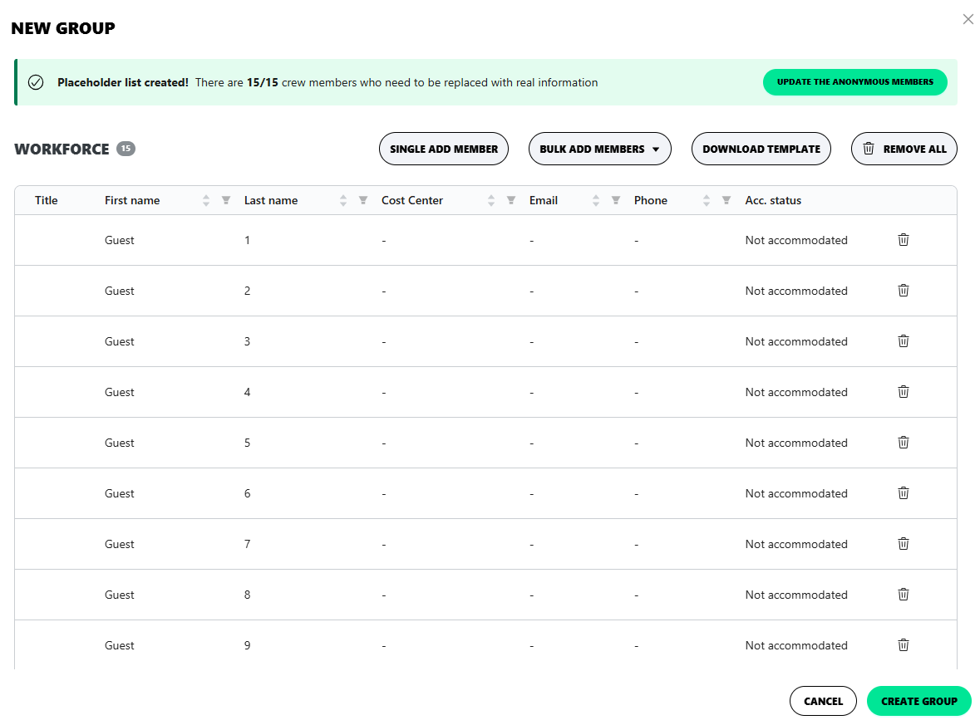
section 2
Create group
A placeholder list will be created.
To manage the Rooming List:
Click on “Update the Anonymous Members” and upload a list to replace the placeholder information
13

Slide 14
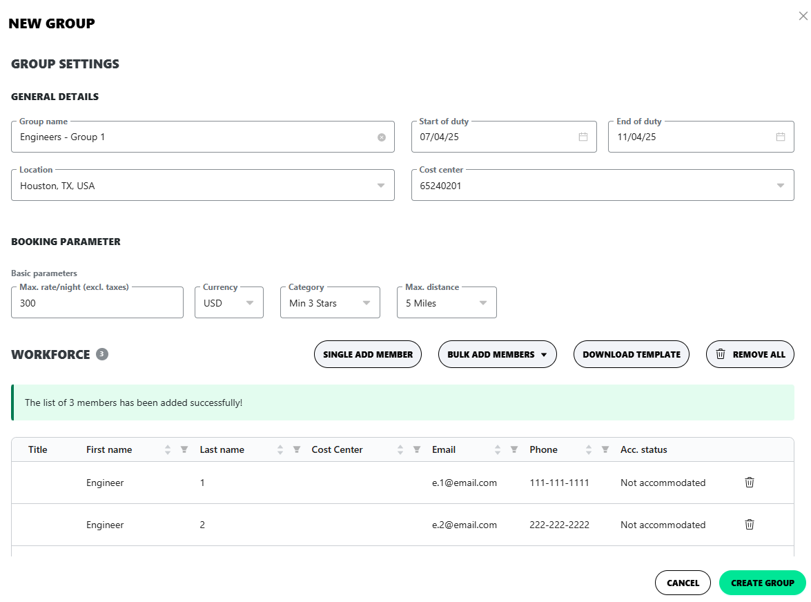
section 2
Create a group
Step 5: The travelers will be added accordingly. Click on “Create group” to finalize the process
14

Slide 15
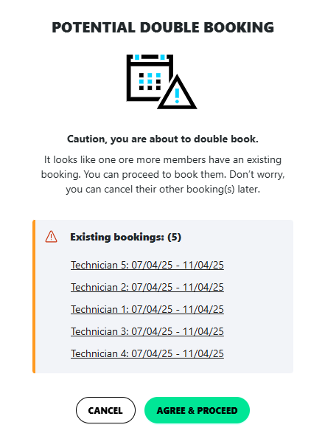
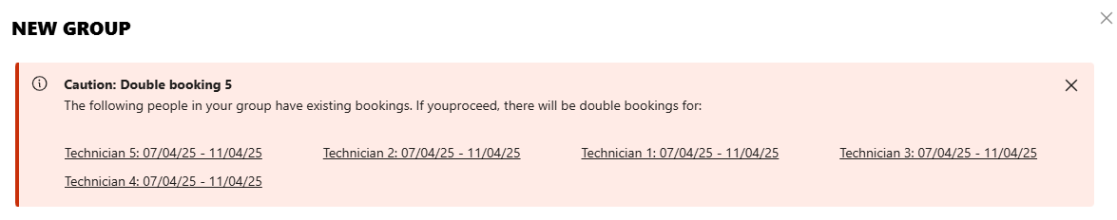
section 2
Create a group
NOTE: You will receive alerts if any traveler is part of another project on the same dates to avoid double-bookings and penalties
15

Slide 16
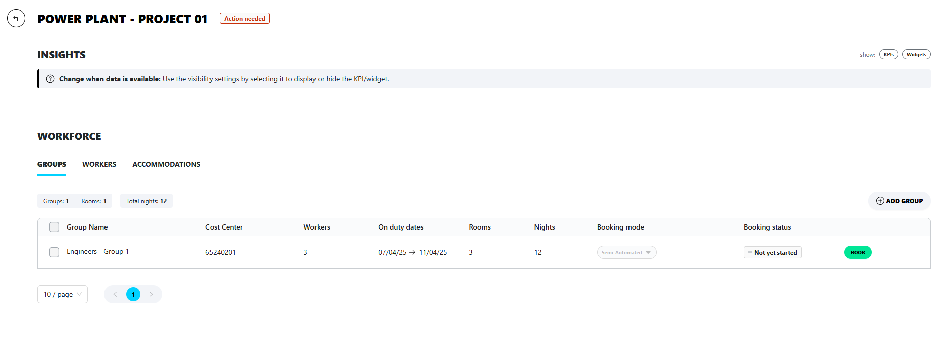
section 2
NOTE: Click on “add group” and follow the same steps to create other groups
Create a group
16

Slide 17
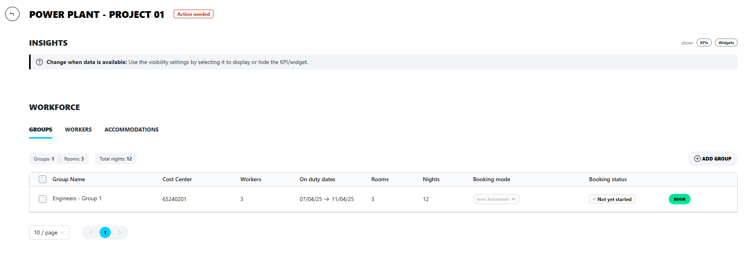
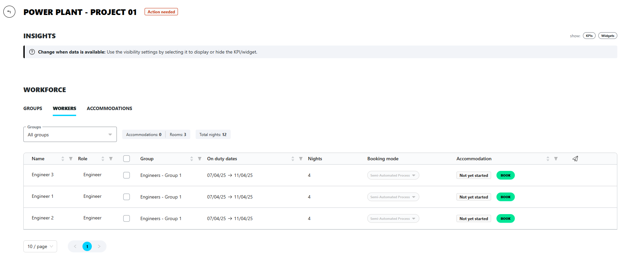
section 3
Booking process
Step 1: Click on “Book” on the Groups tab to book a stay for the entire group (or click on “Book” on the Workers tab to book stays individually)
17

Slide 18
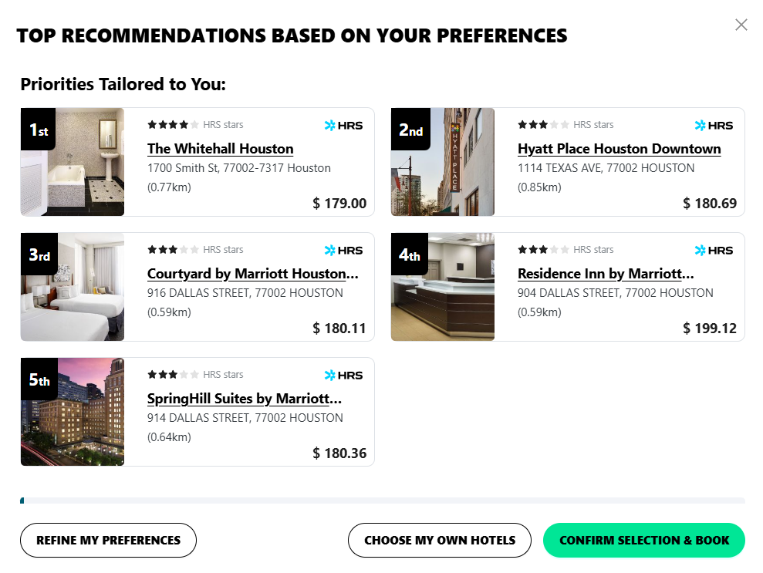
section 3
Booking process
Step 2: The system will present the top hotel recommendations (up to 5 options)
Step 3: Click on “Choose My Own Hotels”, to choose other hotels or change the order of the pre-selected ones, “Refine My Preferences” to filter the options further or click on “Confirm Selection and Book” to proceed as suggested
18

Slide 19
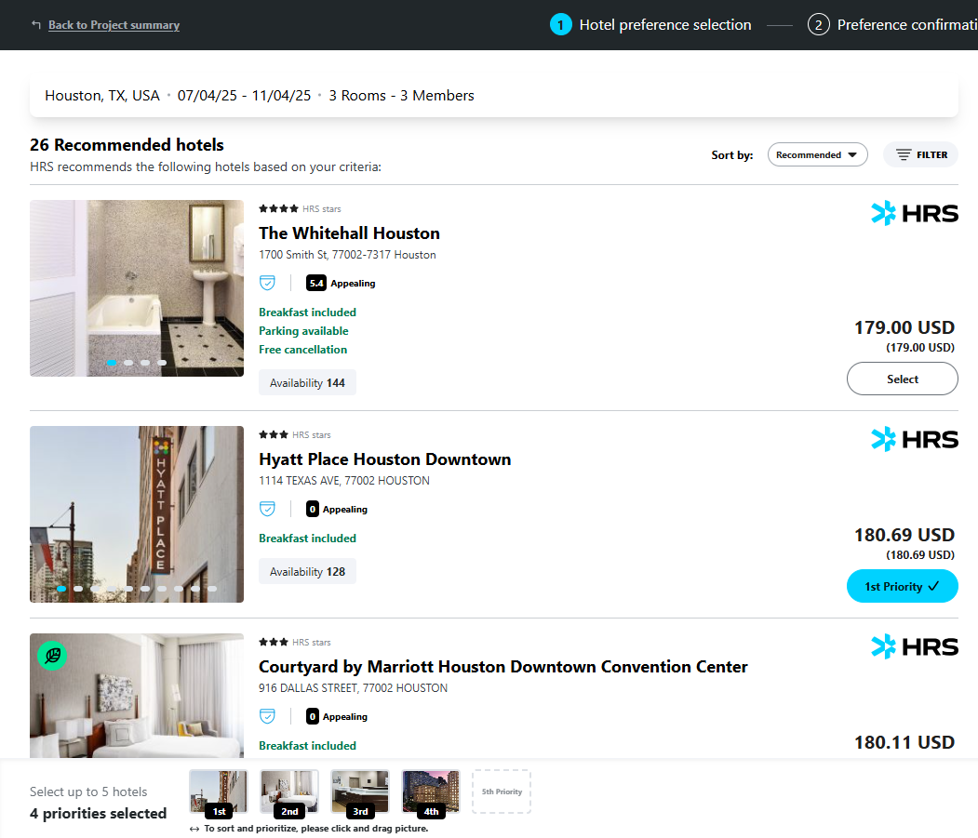
section 3
Booking process
Step 4: By selecting “Choose My Own Hotels” the system will allow you to organize them in the order of your preference (up to 5 hotels). Click on “Select” and the button color will change from “Select” (grey) to the option’s priority number (blue). Change the order quickly at the bottom of the page by clicking and dragging the hotel picture
19

Slide 20
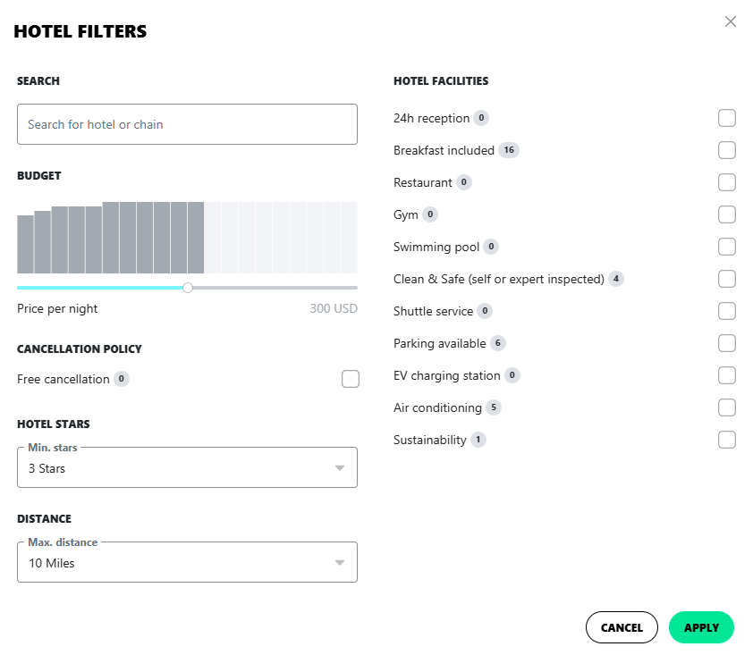
section 3
Booking process
Step 5: Click on filter to refine your hotel search by name, budget, cancelation policy, hotel stars, distance or facilities. Click on “apply”.
20

Slide 21
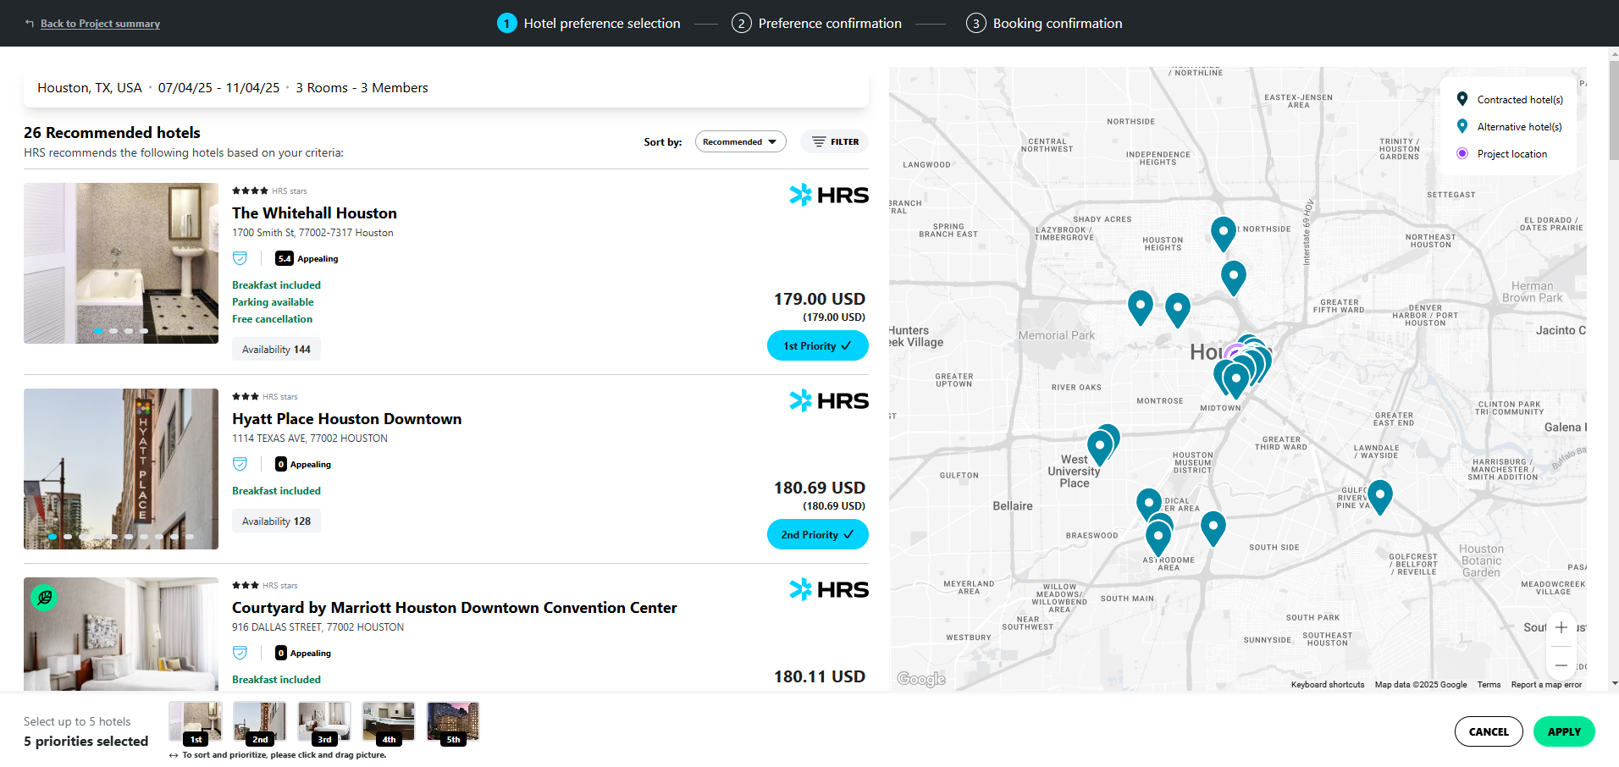
section 3
Step 6: Click on “Apply” to confirm the selection and start the booking process
Booking process
21

Slide 22
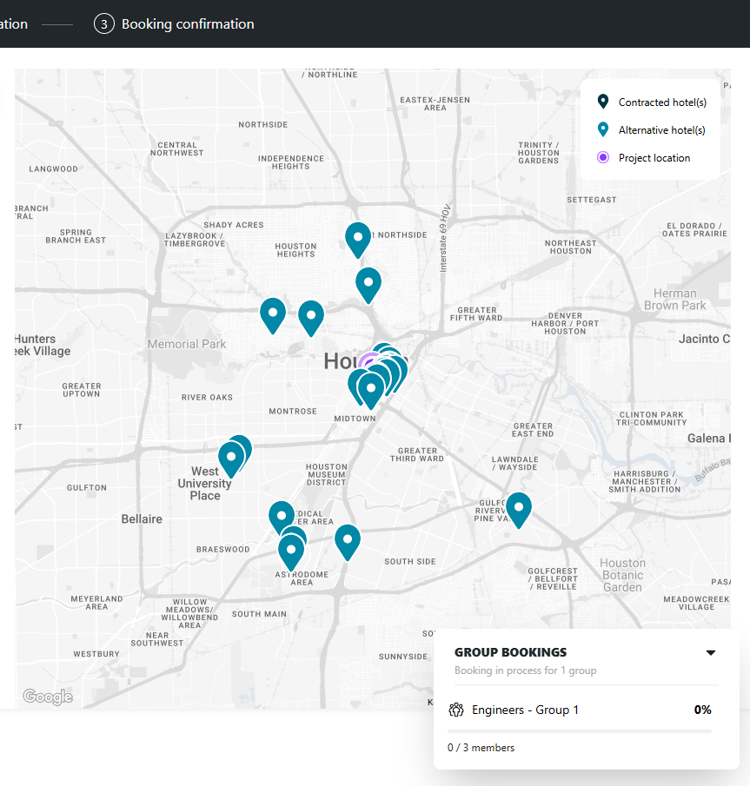
section 3
Booking process
Step 7: The system will show you the booking progress
NOTE: If there is an issue during the booking process it will be shown in this view. Please check the section 4 of this guide for more details
22

Slide 23
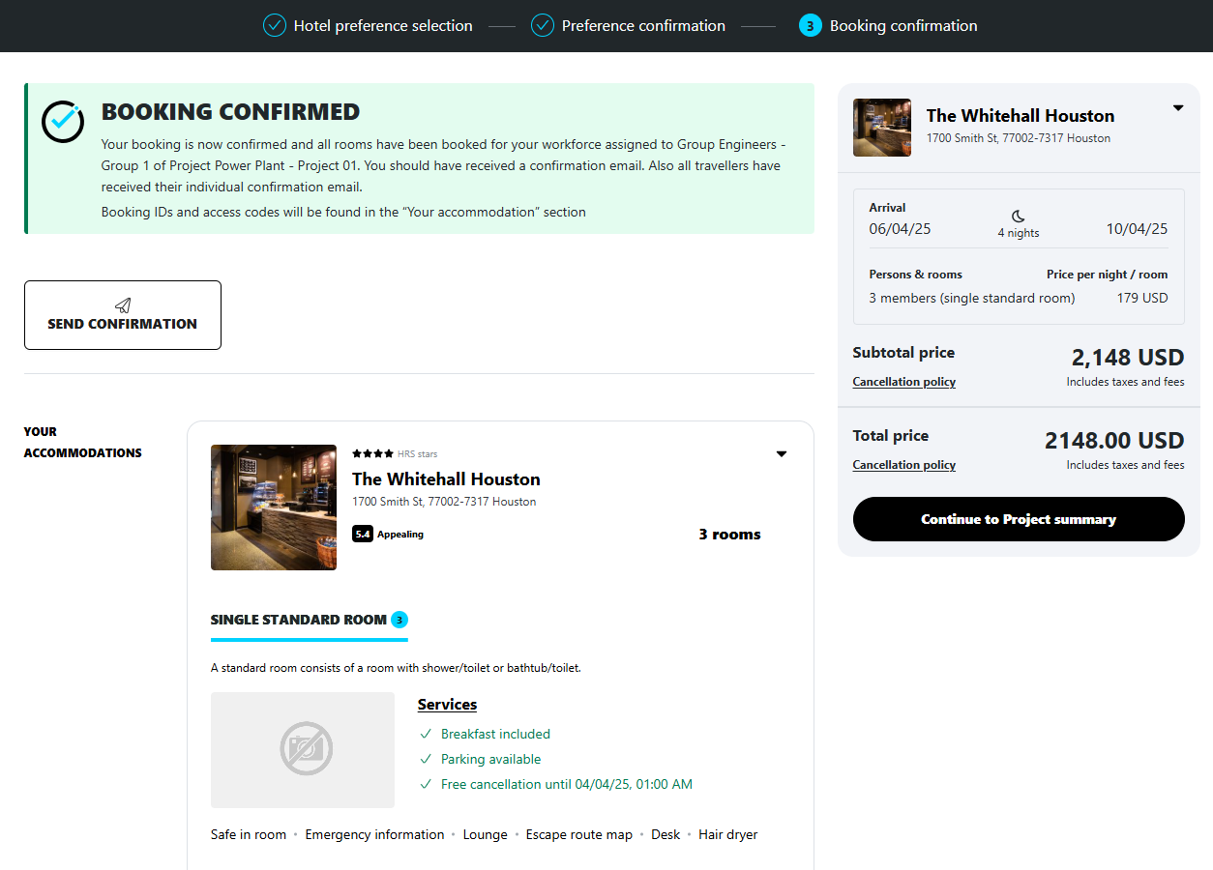
section 3
Booking process
Step 8: The booking confirmation screen will appear when the travelers have been assigned to one or more hotels
Step 9: Click on “Continue to Project Summary” to return to the Project Summary page
23

Slide 24
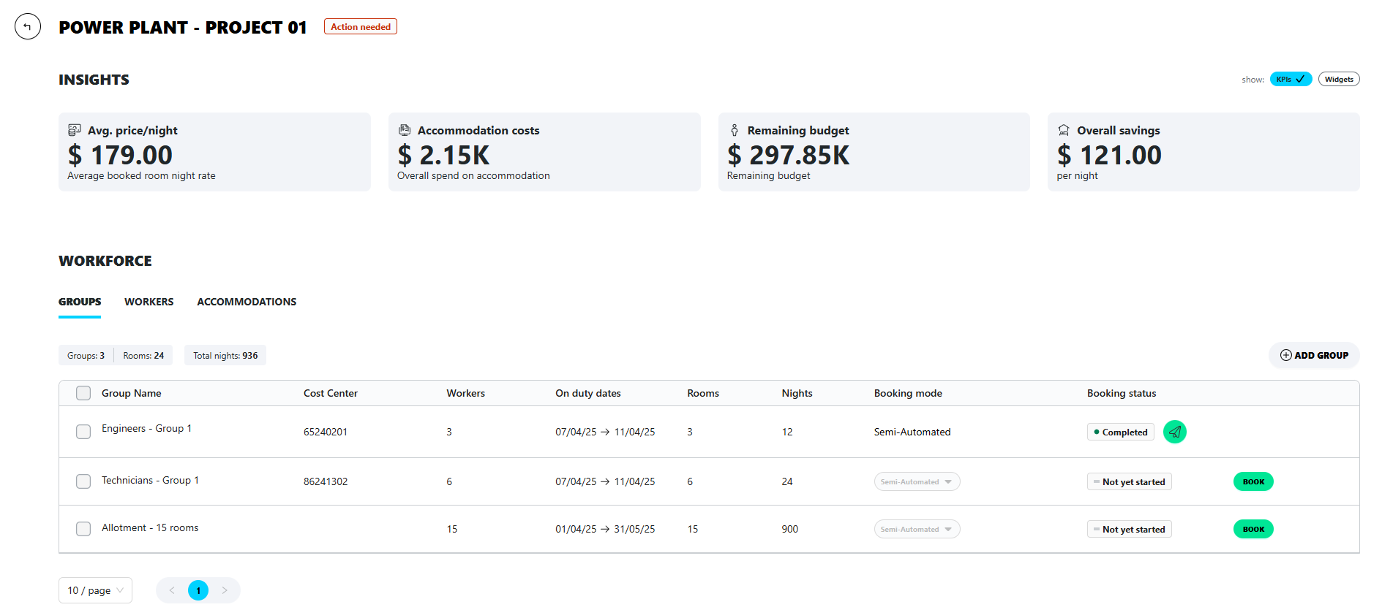
section 3
NOTE: The project and group booking status will be automatically updated as well as the KPIs
Booking process
24

Slide 25





section 3
Status | Explanation
 | There are no travelers added to the group yet
 | No booking request has been initiated
 | An issue occurred during the booking process
 | A new member was added to the group that already has assigned accommodation.
 | All workforces have assigned accommodation.
Booking process
Note: The group status will indicate if any actions must be taken
25

Slide 26
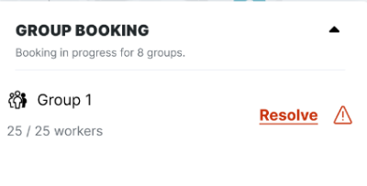
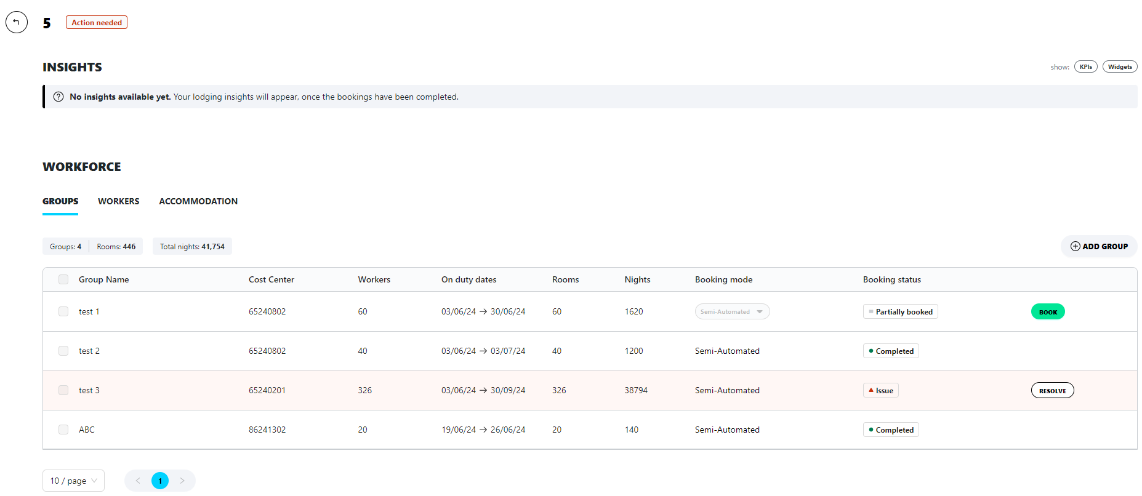

section 4
solving booking issues
Step1:
During the booking process:
Click on “Resolve”
OR
On the group workforce tab:
Click on “Resolve” to solve the booking issue
26

Slide 27
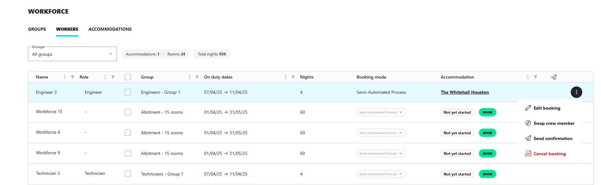
section 5
Note: Edit, cancel, swap crew members or resend booking confirmation on the Workers tab. Click on the ellipsis and select the desired option.
Managing bookings
27

Slide 28
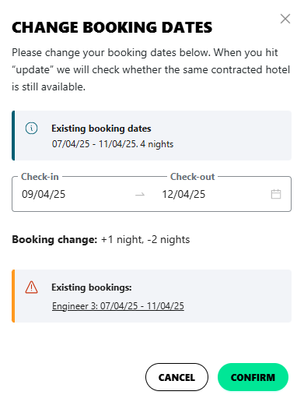

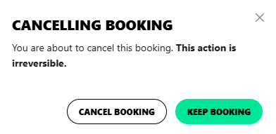
section 5
Managing bookings
To change booking dates:
Click on “Edit”, select the new dates and click “Confirm”
To replace crew member:
Click on “Send Confirmation”
To cancel reservation:
Click on “Cancel Booking” and “Cancel Booking” to confirm
28

Slide 29
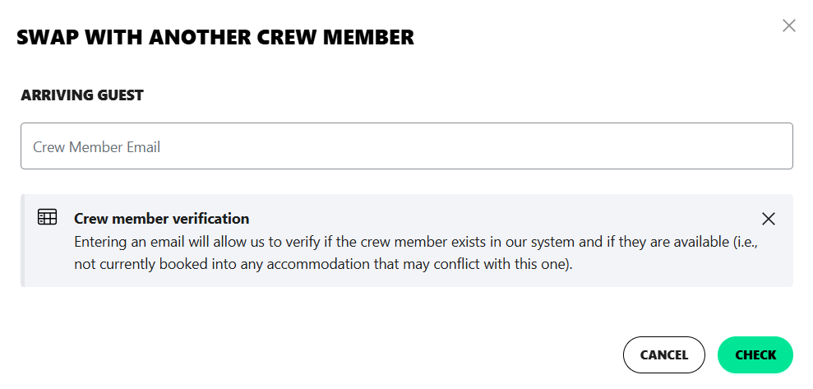
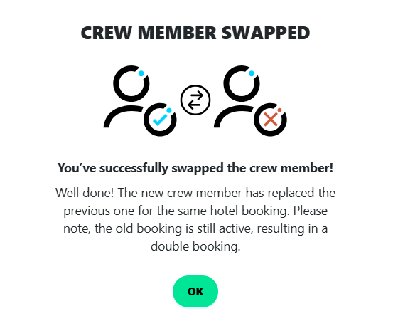
section 5
Managing bookings
To replace crew member:
Click on “Swap Crew Member”, enter the new crew member’s email and click on “Check”.
Add new crew member or confirm if the crew member has been verified by the system.
A pop-up message will confirm the swap, the list will be updated and all stakeholders will be informed automatically.
29

Slide 30
Thank you

