Slide 1
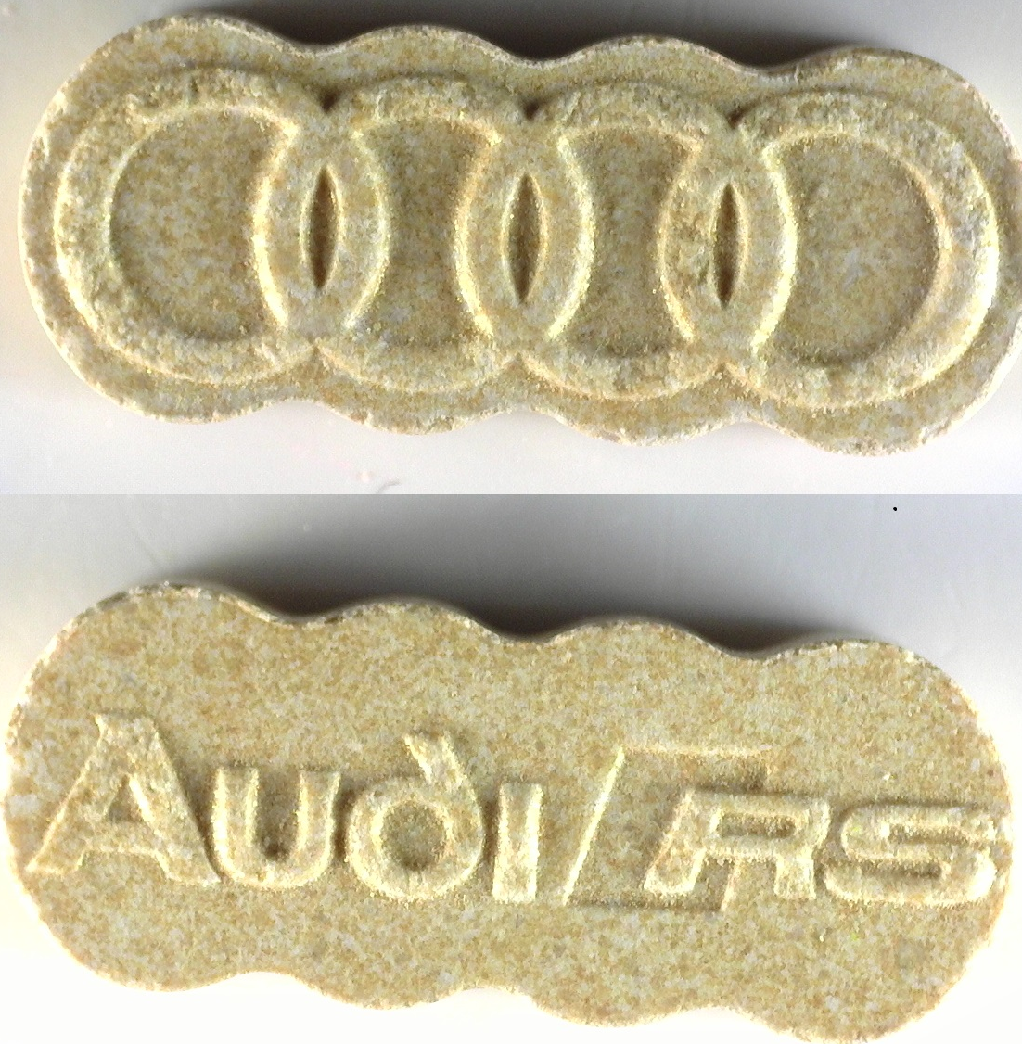
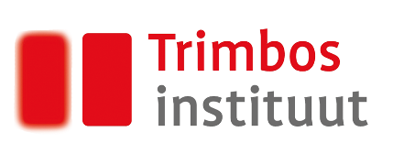
Warning!
very high-strength ecstasy pills in circulation
8 december 2023
Beige-golden ecstasy pills with Audi-logo contain over 300 mg MDMA!
These pills were submitted at several testservices throughout the Netherlands.
Intake of a high dosage of MDMA can be life-treathening and lead to overheating and loss of conciousness.
Do not use this pill.
Alert the medical service (“EHBO”) if you or somebody else has taken this pill and experiences adverse effects.
Drug use is never safe. If you feel unwell you can always seek medical assistance without risk of prosecution.

