Slide 1
HALİSE ATABAY – Board Member
KEMAL BARAN YILDIRIM – Board Member
AIPPI TÜRKİYE

Slide 2


Table of Content
1
NRG Leadership
2
NRG Member Activities
3
NRG Members Participation
4
Study Questions
5
NRG Representation
6
NRG Challenges
7
AIPPI Alternative Approaches
You can click on the link (“Ctrl+left mouse click”) to jump directly to the corresponding topic
To jump back (“Ctrl+left mouse click”) to this page ->

Slide 3
NRG Leadership
Team (changes)
President | MELİS ABACIOĞLU
Vice-President | BARIŞ ATALAY
Secretariat General | MİNE AKARSU
Treasurer | MESUD KORKUT ÜZÜM
Group Reporter (if not, could you nominate one?) | MERVE TUNCER
Board Members | KEMAL BARAN YILDIRIM, AYŞE İLDEŞ ERDEM, ELİF TÜRKAN DİNÇER, ZEYNEP SEDA ALHAS, HALİSE ATABAY
Leadership Meetings | In addition to the Board, President of the Supervisory Board and Disciplinary Board, our Leadership Team consists of moderators of NG Committees, NG Reporter and Study Questions Moderator. Leadership Meeting held on 6 May 2025. Content of the leadership meetings are briefly; presentations and update from the Committees, Sub-Committees and NG Reporter.
Other Meetings | An 'Open Forum' event with our members to discuss the recent increase in challenges concerning registry procedures and practices before TÜRKPATENT was held on 2 December 2025.
Membership Developments (statistics) | 244 member as of December 2025. (Decrease around %7,22)
…

Slide 4
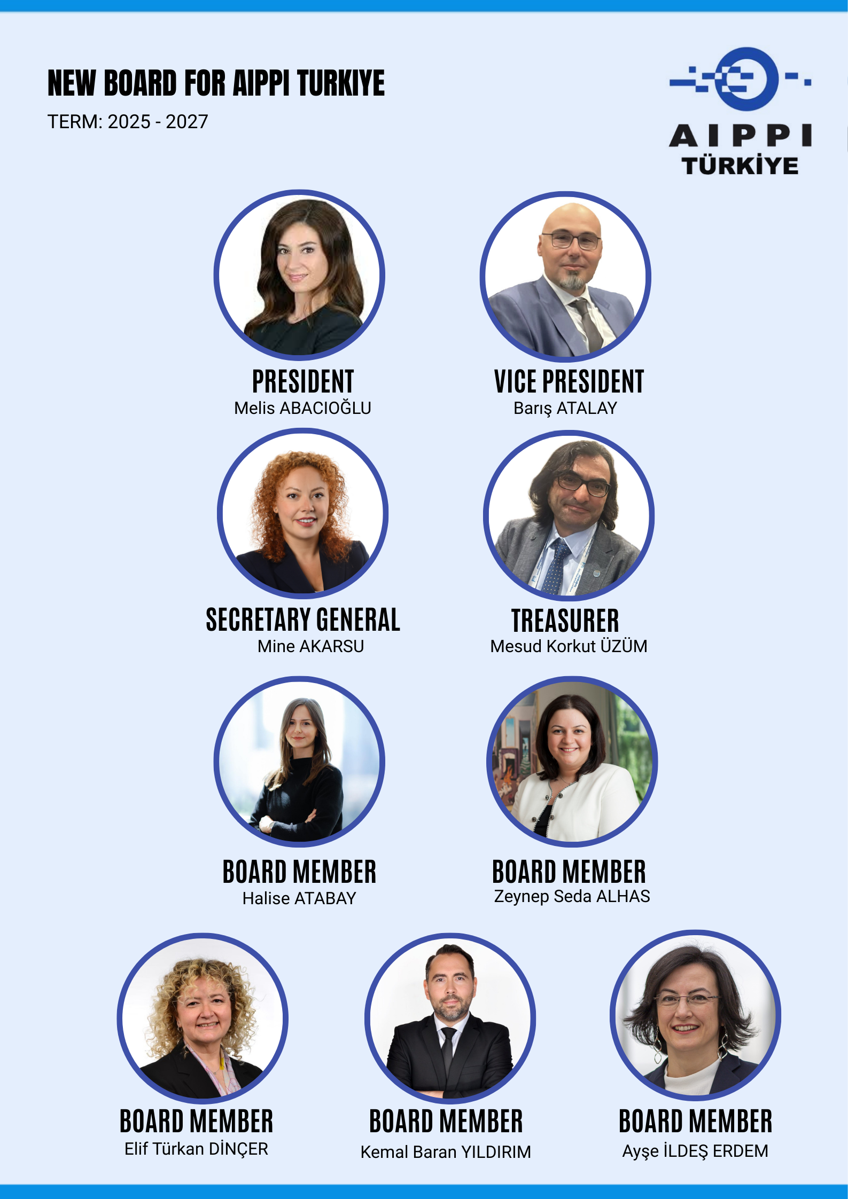
NRG Leadership

Slide 5
NRG Member Activities
Proudly share events, pictures, promotions, social media posts, comments, so that others can learn; add numbers and participation figures to understand context
General Assembly | March 26, 2025 (62 participants)
Educational activities | -AIPPI Türkiye Webinar Series 1 & 2: Artificial Intelligence and Copyright Law (online, January 29, 2025 & February 12, 2025) -SERTAÇ KÖKSALDI 6TH INTERNATIONAL INTELLECTUAL PROPERTY LAW SEMINAR (in-person, April 3-4, 2025) -“Copyright in Cinematographic Works, Trademark Protection, and Music” held within the scope of World Intellectual Property Day (online - April 28, 2025) -“Post-Grant Opposition in Patents” (online - July 1, 2025) -“Assessment of Offering Different Product Qualities Under the Same Trademark from a Trademark and Unfair Competition Perspective” Breakfast Meeting (in-person, September 3, 2025) -Panel: “Use of Trademarks as ‘Keywords’ and Infringement Through Social Media” (in-person, December 25, 2025) -AIPPI Türkiye Mock Trial Study: A Practical Perspective on Trademark Infringement and Invalidity Actions (in-person, December 25, 2025)
Special activities for young members | “Conflict, Anger, and Stress Management in Professional Life for Intellectual Property Professionals”- Online webinar exclusively for Young Members held on February 24, 2025.
Social Events | -Official visit of the AIPPI Türkiye Group to Anıtkabir (Ankara, Türkiye – November 12, 2025). -New. Year Party 2025 (in-person, December 26, 2025)

Slide 6
NRG Member Activities
Proudly share events, pictures, promotions, social media posts, comments, so that others can learn; add numbers and participation figures to understand context
Promotion of AIPPI (e.g. meetings with governmental organisations, talking about AIPPI at Universities) | -As the Board of AIPPI Türkiye, we paid a visit to the Turkish Patent and Trademark Office on June 11, 2025. All members of our Board of Directors attended the meeting, together with our President, Vice President, Treasurer, and Secretary General. Representing TÜRKPATENT were the Vice President of the Office, the Head of the Re-Examination and Evaluation Department, the Chief Legal Counsel (1st Legal Counsel), the Head of the Information Technologies Department, and the Office of the President. -At the YASED International Investors Association meeting held on August 7, 2025, our President, Attorney Melis Abacıoğlu, presented AIPPI’s activities at both the global and local levels, highlighted the strategic importance of intellectual property rights in the investment environment, and addressed practical challenges encountered in Türkiye. Our Board Member Halise Atabay discussed the relationship between intellectual property rights and the Sustainable Development Goals, emphasizing the importance of making patents accessible for public benefit on the basis of social utility. In the continuation of the meeting, our Vice President Barış Atalay and our Board Member Elif Türkan Dinçer delivered presentations on the patentability of AI-based inventions and the current debates surrounding the copyright protection of works generated by artificial intelligence. -“Intellectual Property Rights Arising from the Legislation and Practices of Regulatory and Supervisory Authorities” – Joint event organized by AIPPI Türkiye and the Intellectual Property Law Research and Practice Center of Istanbul Bilgi University (in-person, October 8, 2025).

Slide 7


NRG Member Activities
LinkedIn (e.g. link, purpose, examples and quantity of posts) | https://www.linkedin.com/in/aippiturkey/ More than 40+ posts sharing activities, announcements and publishings of AIPPI Türkiye
Instagram (e.g. link, purpose, examples and quantity of posts) | https://www.instagram.com/aippiturkiye/
Local Publications (e.g. like newsletter, articles for magazines) | AIPPI TÜRKİYE JOURNAL: FİKRİ GÜNDEM

Slide 8


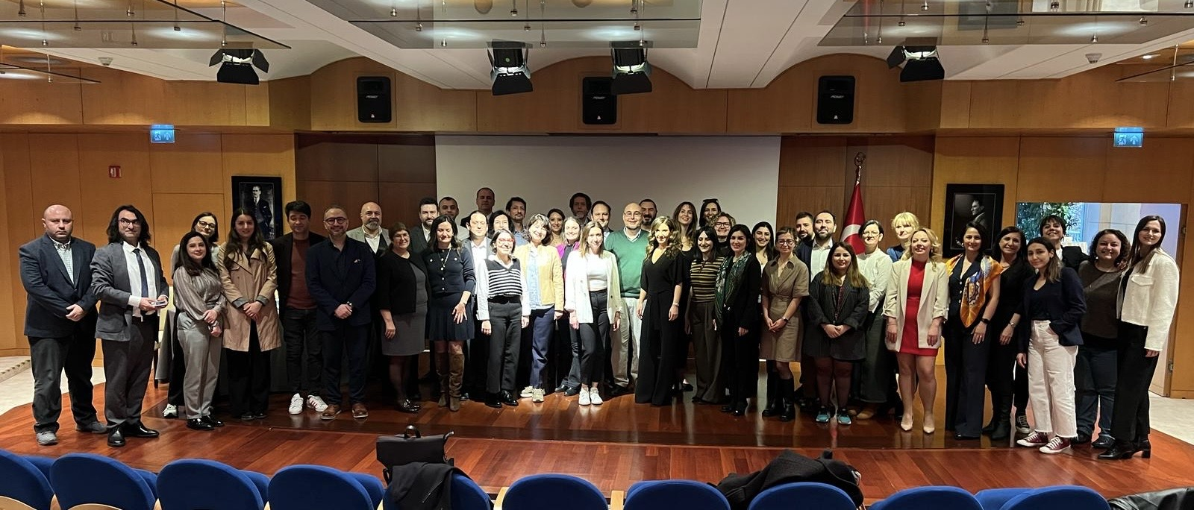
NRG Member Activities
General Assembly 2025

Slide 9

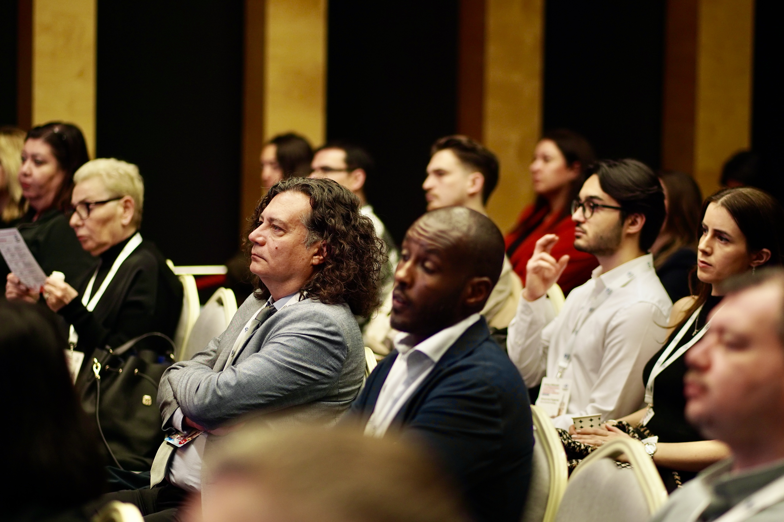
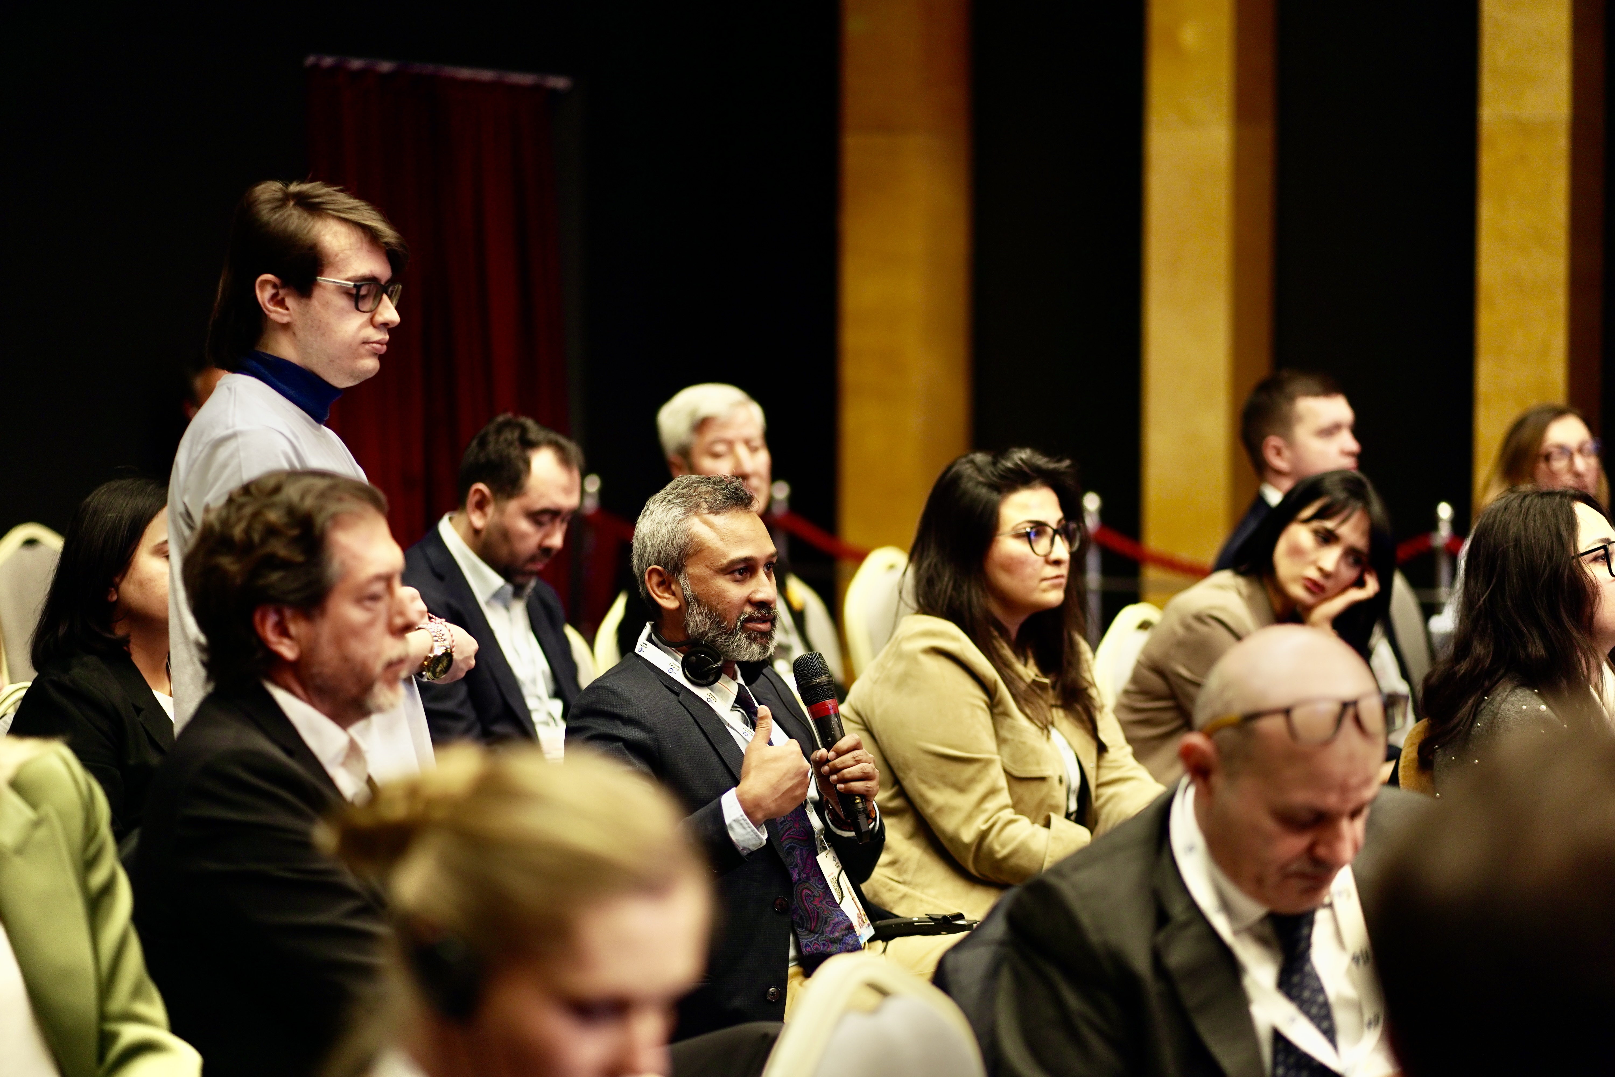
NRG Member Activities

Slide 10
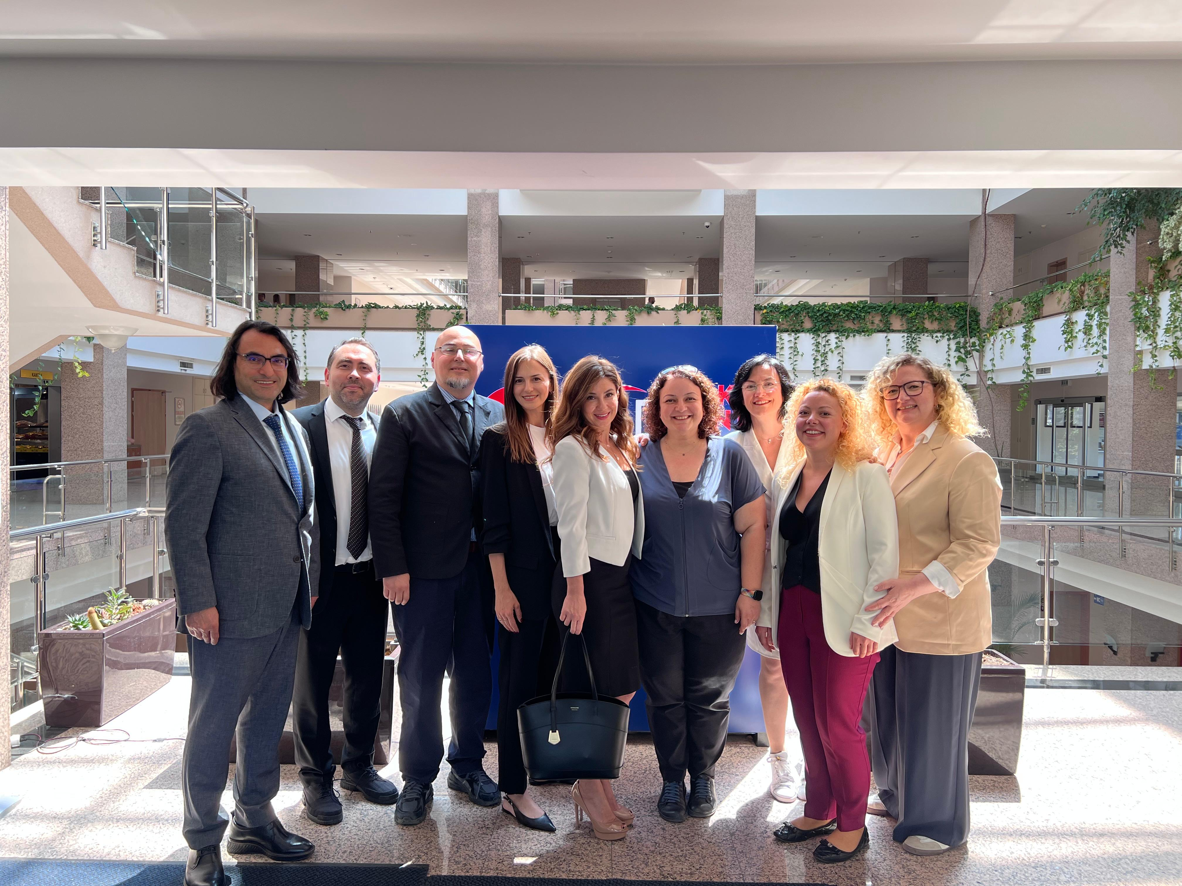
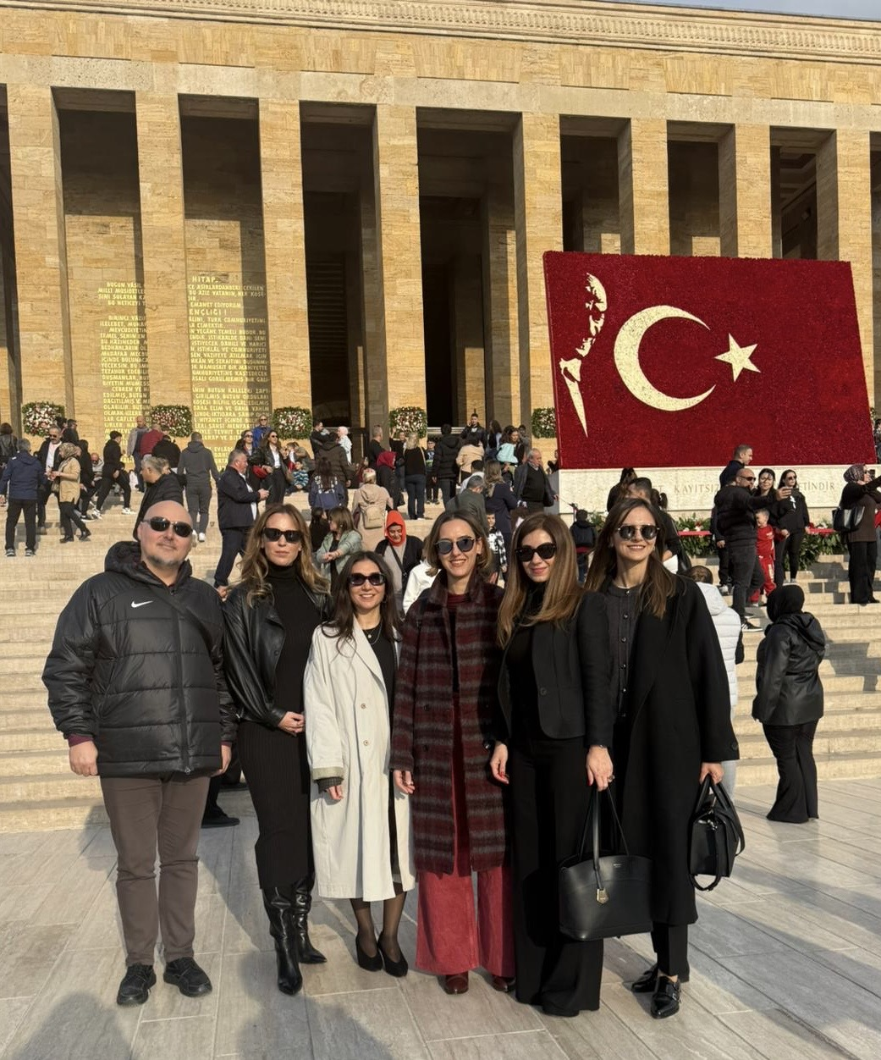
NRG Member Activities

Slide 11



NRG Member Activities

Slide 12


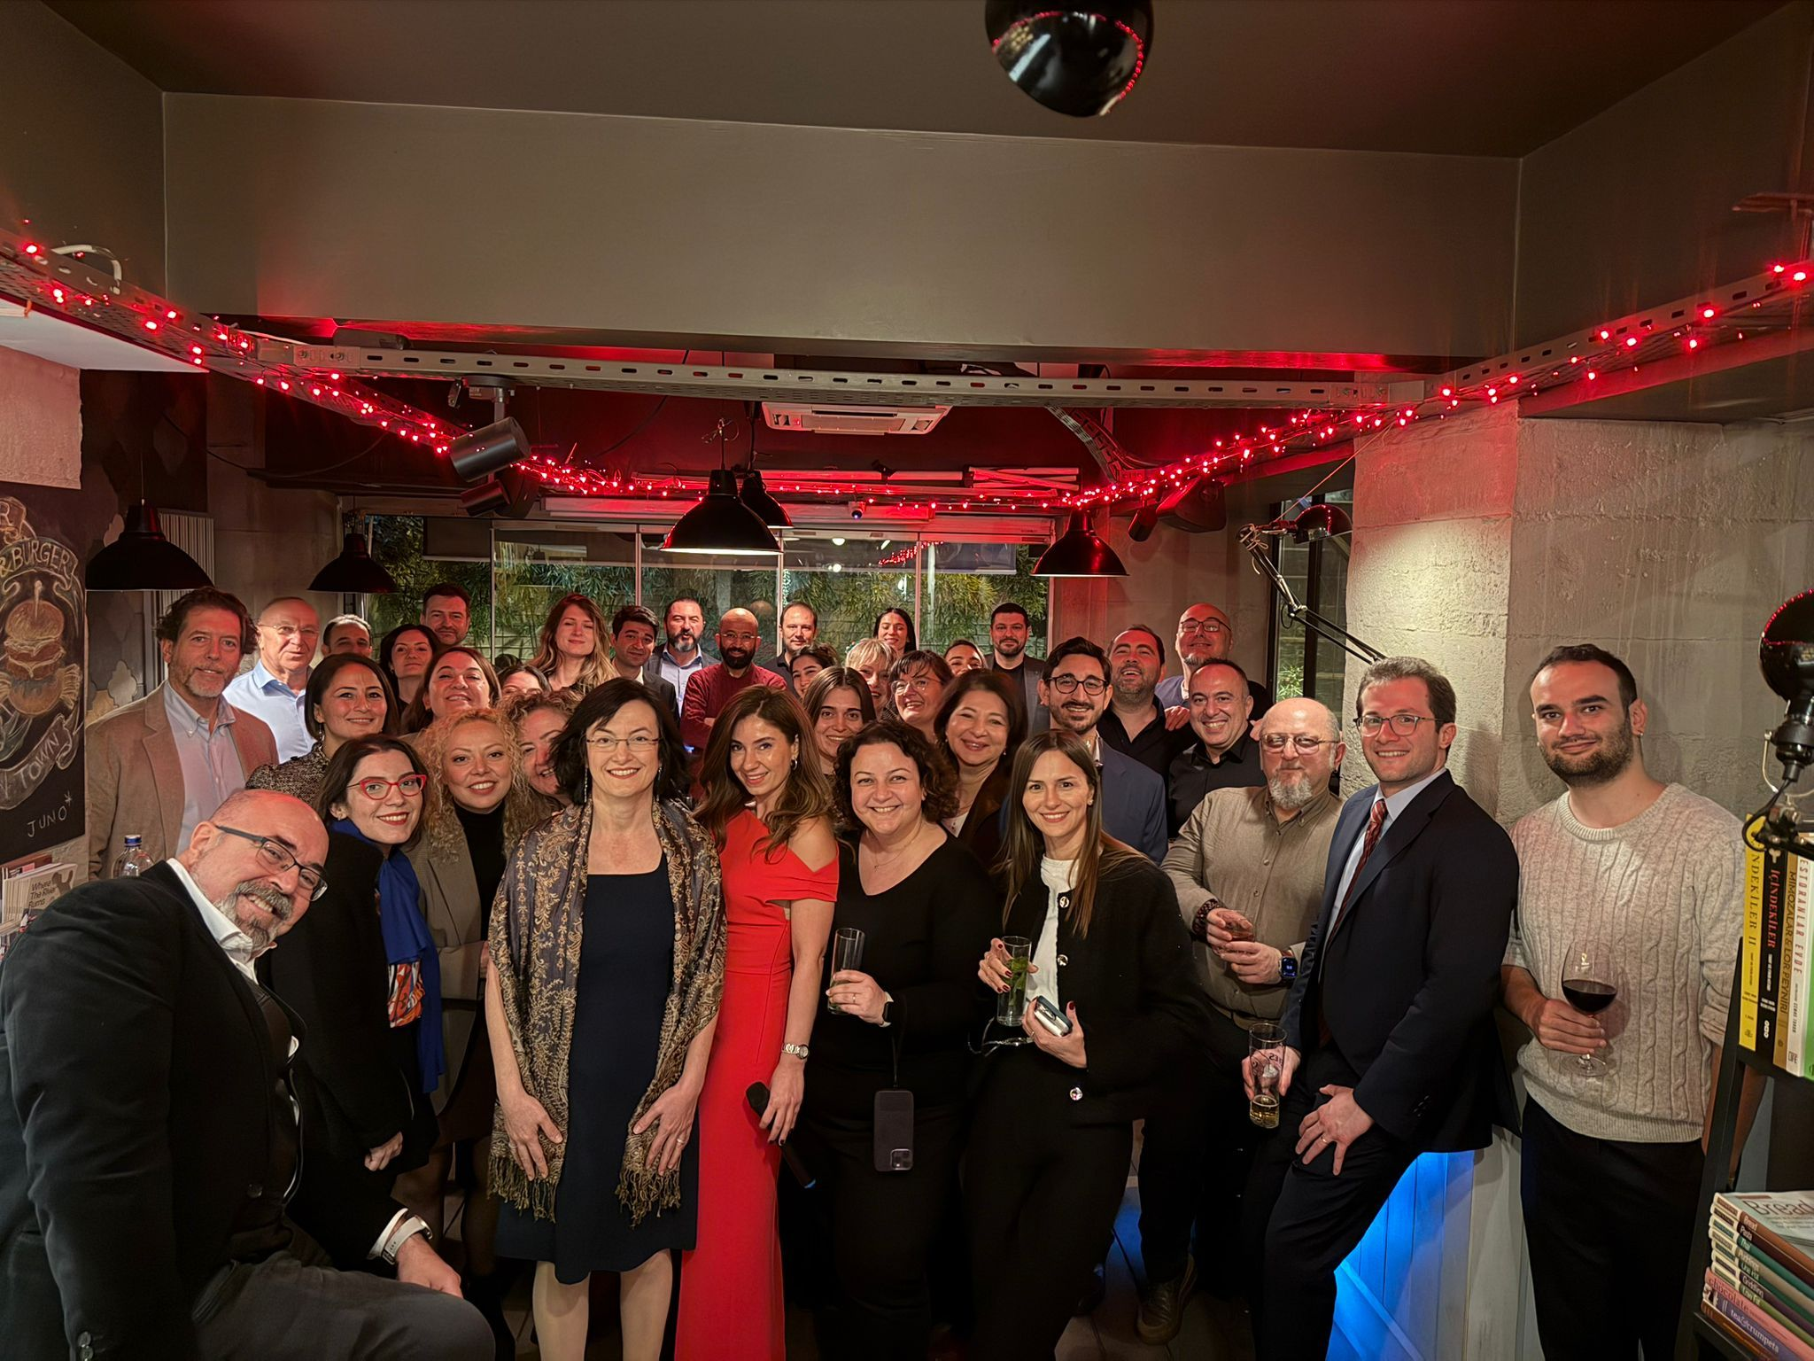
NRG Member Activities
New Year Party

Slide 13
NRG Members Participation
In which committees are your members
represented in 2025?
(Standing, Statutory and Bureau Advisory Committees)
Number of person | Committee
1 | Nominating (Irmak Yalçıner Öktem - Chair)
1 | Communications (Melis Abacıoğlu - Vice-Chair)
1 | Membership (İrem Çağlar Hamamcıoğlu)
1 | Venue Selection (Esra Dündar Loiseau)
1 | Programme (Emre Kerim Yardımcı)
2 | In-house (İrem Çağlar Hamamcıoğlu - Ezel Uraz Bakırcı)
1 | Young AIPPI Members (Halise Atabay)
1 | Diversity and Inclusion (Mine Akarsu)

Slide 14
NRG Members Participation
In which committees are your members
represented in 2025?
(Standing, Statutory and Bureau Advisory Committees)
Number of person | Standing Committee
1 | ADR (Elif Türkan Dinçer)
3 | Biotechnology (Merve SÖYLEYİCİ, Canan ÖZTÜRKER, Zeynep KARAKÖY
1 | Client Attorney Privilege (Berrin Dinçer)
2 | Commercialisation of Data and IP (İdil Buse Kök, Nihan Güneli)
3 | Copyright (Berrin DİNÇER, Nihan GÜNELİ, Ertuğrul AKINCI)
2 | Designs (Irmak YALÇINER, İbrahim Barış SAYAR)
1 | Development and IP (Esra Böğürcü Süngerli)
2 | Enforcement (Muazzez KORUTÜRK, Merve ALTINAY)
1 | Free Trade Agreements (Nihan Güneli)

Slide 15
NRG Members Participation
In which committees are your members
represented in 2025?
(Standing, Statutory and Bureau Advisory Committees)
Number of person | Standing Committee
2 | Geographical Indications (Ekin KARAKUŞ ÖCAL , Özlem FÜTMAN)
3 | Information Technology and Internet (Elif ARABACIOĞLU, Pelin AYDOĞDU, Sinan ERKAN)
3 | IP and Sustainability (Yağmur AKTAN, Alihan KAYA, Melis SILACI KORKMAZ)
2 | IP Office Practice & Procedures (Hakan PEHLİVAN, Rıza Ferhan ÇAĞIRGAN)
1 | PCT (Sibel Gümüş)
4 | Patents (Neriman Dilek YILDIRIM, Nevin ÖNER, Aysel KORKMAZ, Soley ÇOBAN)
4 | Pharma (Ezgi BAKLACI GÜLKOKAR, Soley ÇOBAN , Sevda Selime KALYONCU, Ezel URAZ BAKIRCI)
1 | Piracy and Counterfeiting (Zeynep Seda Alhas)
3 | Plant Varieties (Melis ABACIOĞLU, Yeşim METİN, Furkan Ali DÖNMEZ)

Slide 16
NRG Members Participation
In which committees are your members
represented in 2025?
(Standing, Statutory and Bureau Advisory Committees)
Number of person | Standing Committee
2 | Standards and Patents (Ekrem SOYLU, Selin Sinem ERCİYAS)
2 | Trade Secrets (Mine AKARSU, Büşra BIÇAKCI)
2 | Trademarks (Melis ABACIOĞLU, Ezgi KORALAY ORUÇ)
1 | TRIPS (Duygu Akşit)
2 | Unitary Patent / Unified Patent Court (Utkan Bahri BAKIRCI, Sevda Selime KALYONCU)

Slide 17
NRG Members Participation
How did the NRG and its members participate in
international AIPPI Committees work in 2025?
(Standing, Statutory and Bureau Advisory Committees)
Date | Description
10.07.2025 | Our member, Büşra Bıçakcı was a speaker at the Global Session of the Young AIPPI Members Summit held on 9-10 July 2025.
06.11.2025 | Our member, Yağmur Aktan was a speaker at the session “Rethinking Copyright Ownership with Artificial Intelligence”, held as a part of AIPPI & ASIPI Webinar as a member of Young AIPPI Members Committee.

Slide 18
NRG Members Participation
How are the NRG and its members planned to participate in international AIPPI Committees' work in 2026?
(Standing, Statutory and Bureau Advisory Committees)
Date | Description
 | N/A

Slide 19
Study Questions
What can you tell us about the Study Question preparation, submission, and promotion within your group?
Date | Description
25.03.2025 | Working group meeting
28.08.2025 | A meeting was held open to all members to discuss the 2025 AIPPI Yokohama Study Questions.
13-16.09.2025 | Representation of NG at the Study Question Meetings and Plenary&ExCo Sessions during the World Congress Yokohama

Slide 20
NRG Representation
What | World Congress 2025 - Yokohama
Congress contribution | Here are some proud highlights from our members: -Nazlı T. Korkut has successfully completed her term as Secretary General within the AIPPI Bureau, succeeded by Regina Quek. -Irmak Yalçıner Öktem has successfully completed her term as Chairperson of the Nominating Committee. -Our President, Melis ABACIOGLU, has been re-elected to the Communications Committee and will continue as Vice Chair. -Esra Dündar-Loiseau has been elected Chairperson of the Venue Selection Committee. -Rıza Ferhan ÇAĞIRGAN has been elected to the Nominating Committee. -İrem Çağlar Hamamcıoğlu continues her role in the Membership Committee. -Our member, Elif Arabacıoğlu actively contributed to the management of the sessions by serving as Vice-Chair (minute-taker) for the trademark study question during both the Study Committee Meeting and the Plenary Session. -Our member, Nevin Öner was a speaker at the WIPO IP Services Users' Session.
GO representation | Nazlı Korkut served as the Secretary General until the World Congress Yokohama
Submitted / published position papers | N/A
AIPPI Newsletter contribution | https://www.aippi.org/news/new-board-for-aippi-turkiye-announced-for-the-2025-2027-term/ https://www.aippi.org/news/as-aippi-turkiye-national-group-we-are-pleased-to-announce-that-we-have-organised-a-wonderful-exciting-seminar/

Slide 21
NRG Challenges
Did you face significant challenge(s) in 2025 in
administration, representation, organising activities, etc.?
Challenges | Overview & how have you solved it
Administration | N/A
Representation | N/A
Activities | N/A

Slide 22
AIPPI Alternative Approaches
Have you seen/experienced any different implementation or approach by your group or other organisation that could be something AIPPI should consider doing? If so, what was it?
Initiative | Description
… | N/A

Slide 23



